Slide 1
Reasons To Study Church History
Helps Us Learn From The Mistakes Of The Past And Avoid Them
To Build Upon Their Successes, So We Can Grow From Them
Helps Us Appreciate The Lord’s Church

Slide 2
Nebuchadnezzar's Dream
#
Gentile Kingdom
Image Symbol
Reign over Israel
1
Babylon (a)
Head of GOLD
625 B.C. TO 539 B.C.
2
Medo-Persia (b)
Chest and Arms of SILVER
539 B.C. TO 331 B.C.
3
Greece
Waist and Thighs of BRONZE
331 B.C. TO 164 B.C. (c)
4
Rome
Legs of IRON
164 B.C. - 70 A.D.
Daniel 2:44 - "In The Days Of These Kings . . .

Slide 3
⁴⁴“And in the days of these kings the God of heaven will set up a kingdom which shall never be destroyed; and the kingdom shall not be left to other people; it shall break in pieces and consume all these kingdoms, and it shall stand forever. ⁴⁵“Inasmuch as you saw that the stone was cut out of the mountain without hands, and that it broke in pieces the iron, the bronze, the clay, the silver, and the gold—the great God has made known to the king what will come to pass after this. The dream is certain, and its interpretation is sure.” - Daniel 2:44,45 NKJV

Slide 4
Jesus Taught:
Mark 9:1 – Some Standing Here Will Not Taste Death Before The Kingdom Comes
Matthew 16:13-19 – “Upon This Rock I Will Build My Church . . . And I Will Give Unto You The Keys Of The Kingdom Of Heaven”

Slide 5
On That Day Of Pentecost
Prophecy Fulfilled
vv.16-21 – Joel 2 – God’s Great And Notable Day
vv. 25-28 – Psalm 16:8-11 – David’s Prophecy
Church Starts – v.38-40
Kingdom Rule Begins Thru Apostles’ Binding Authority, cf. v.42-47 with Matthew 16:18,19

Slide 6
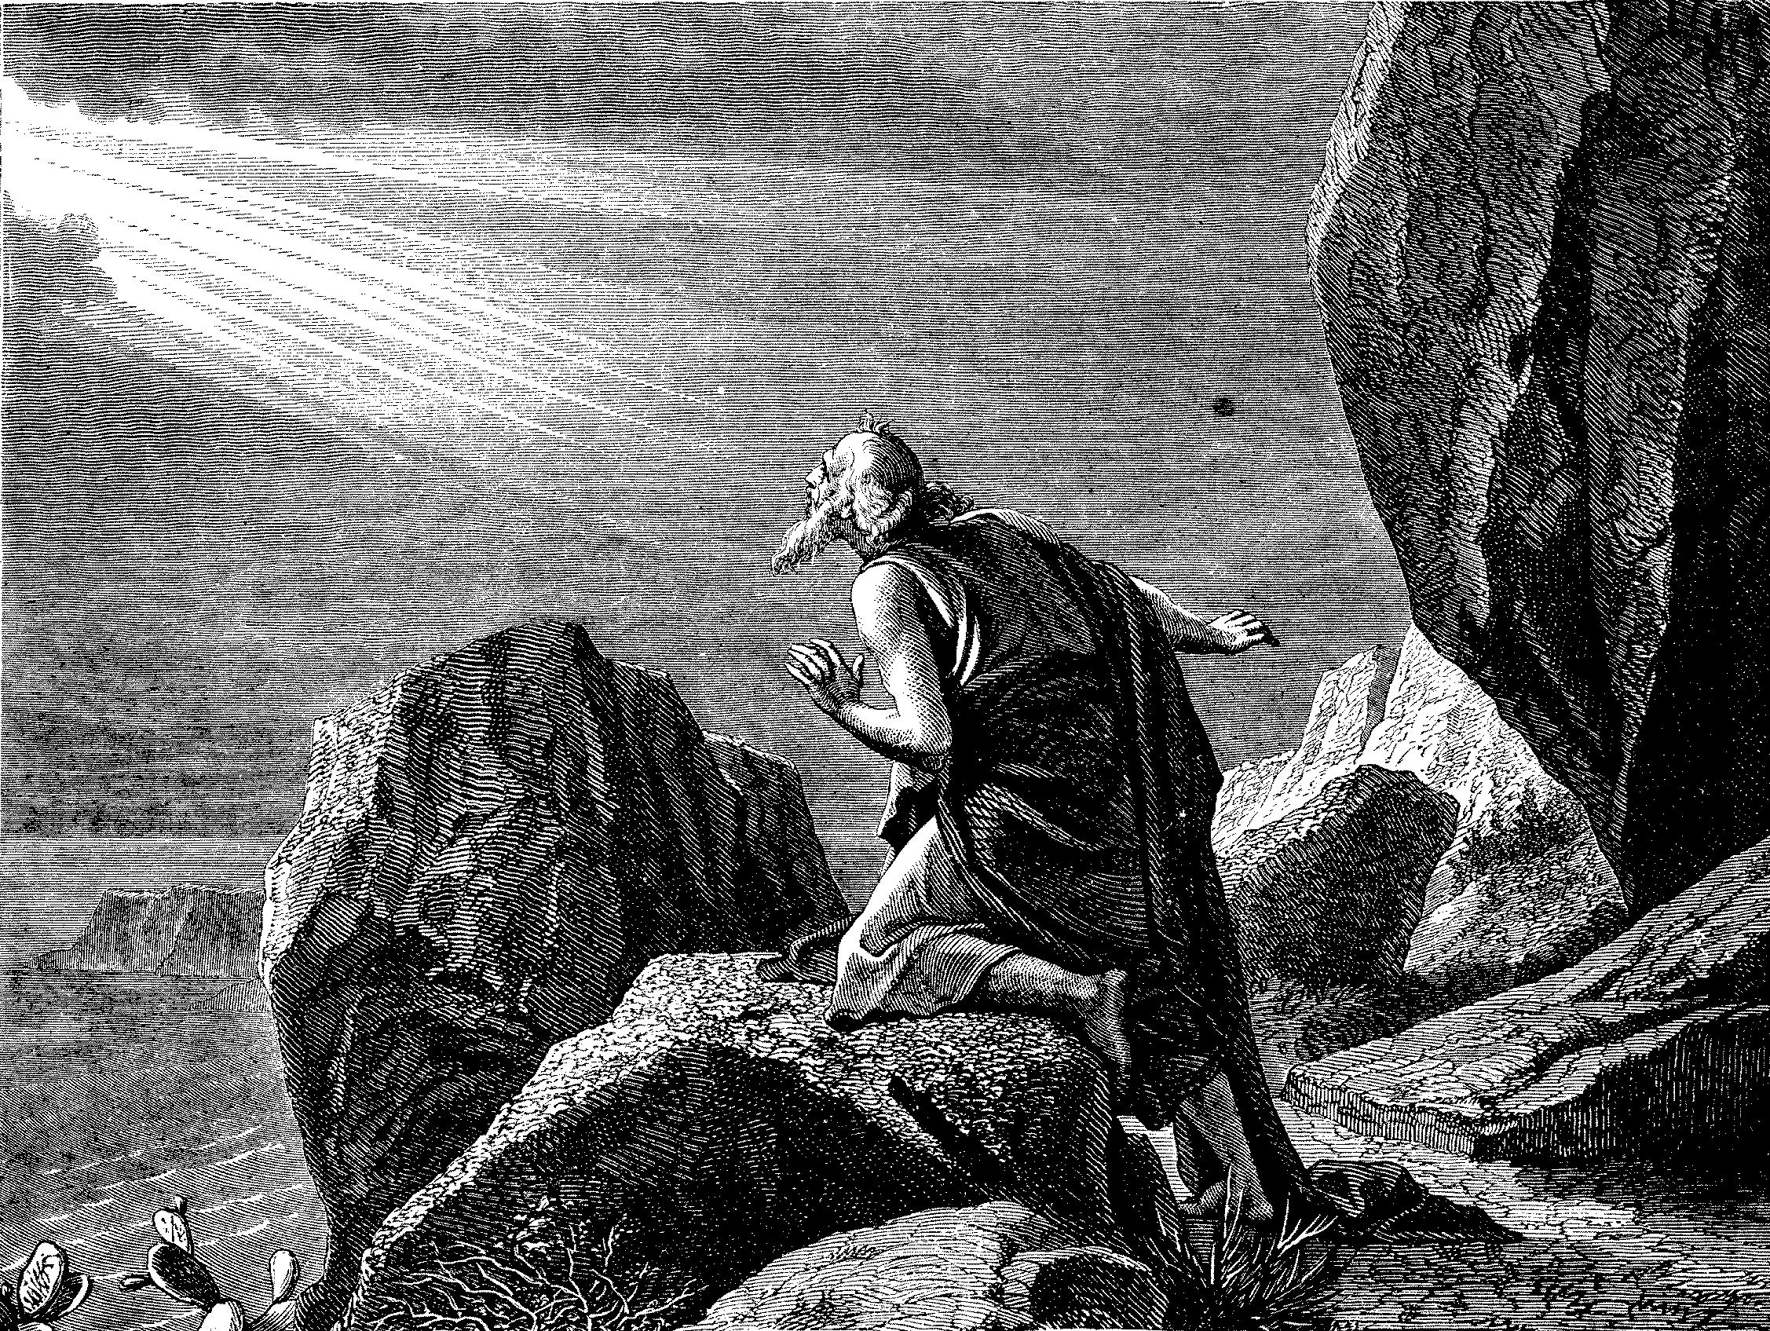
The Kingdom/Church Under Operation In The 1st Century
Colossians 1:12 – “¹³He has delivered us from the power of darkness and conveyed us into the kingdom of the Son of His love, ¹⁴in whom we have redemption through His blood.”
2 Thessalonians 1:5 – “⁵which is manifest evidence of the righteous judgment of God, that you may be counted worthy of the kingdom of God, for which you also suffer;”
Revelation 1:9 – “⁹I, John, both your brother and companion in the tribulation and kingdom and patience of Jesus Christ, was on the island that is called Patmos for the word of God and for the testimony of Jesus Christ.”

Slide 7
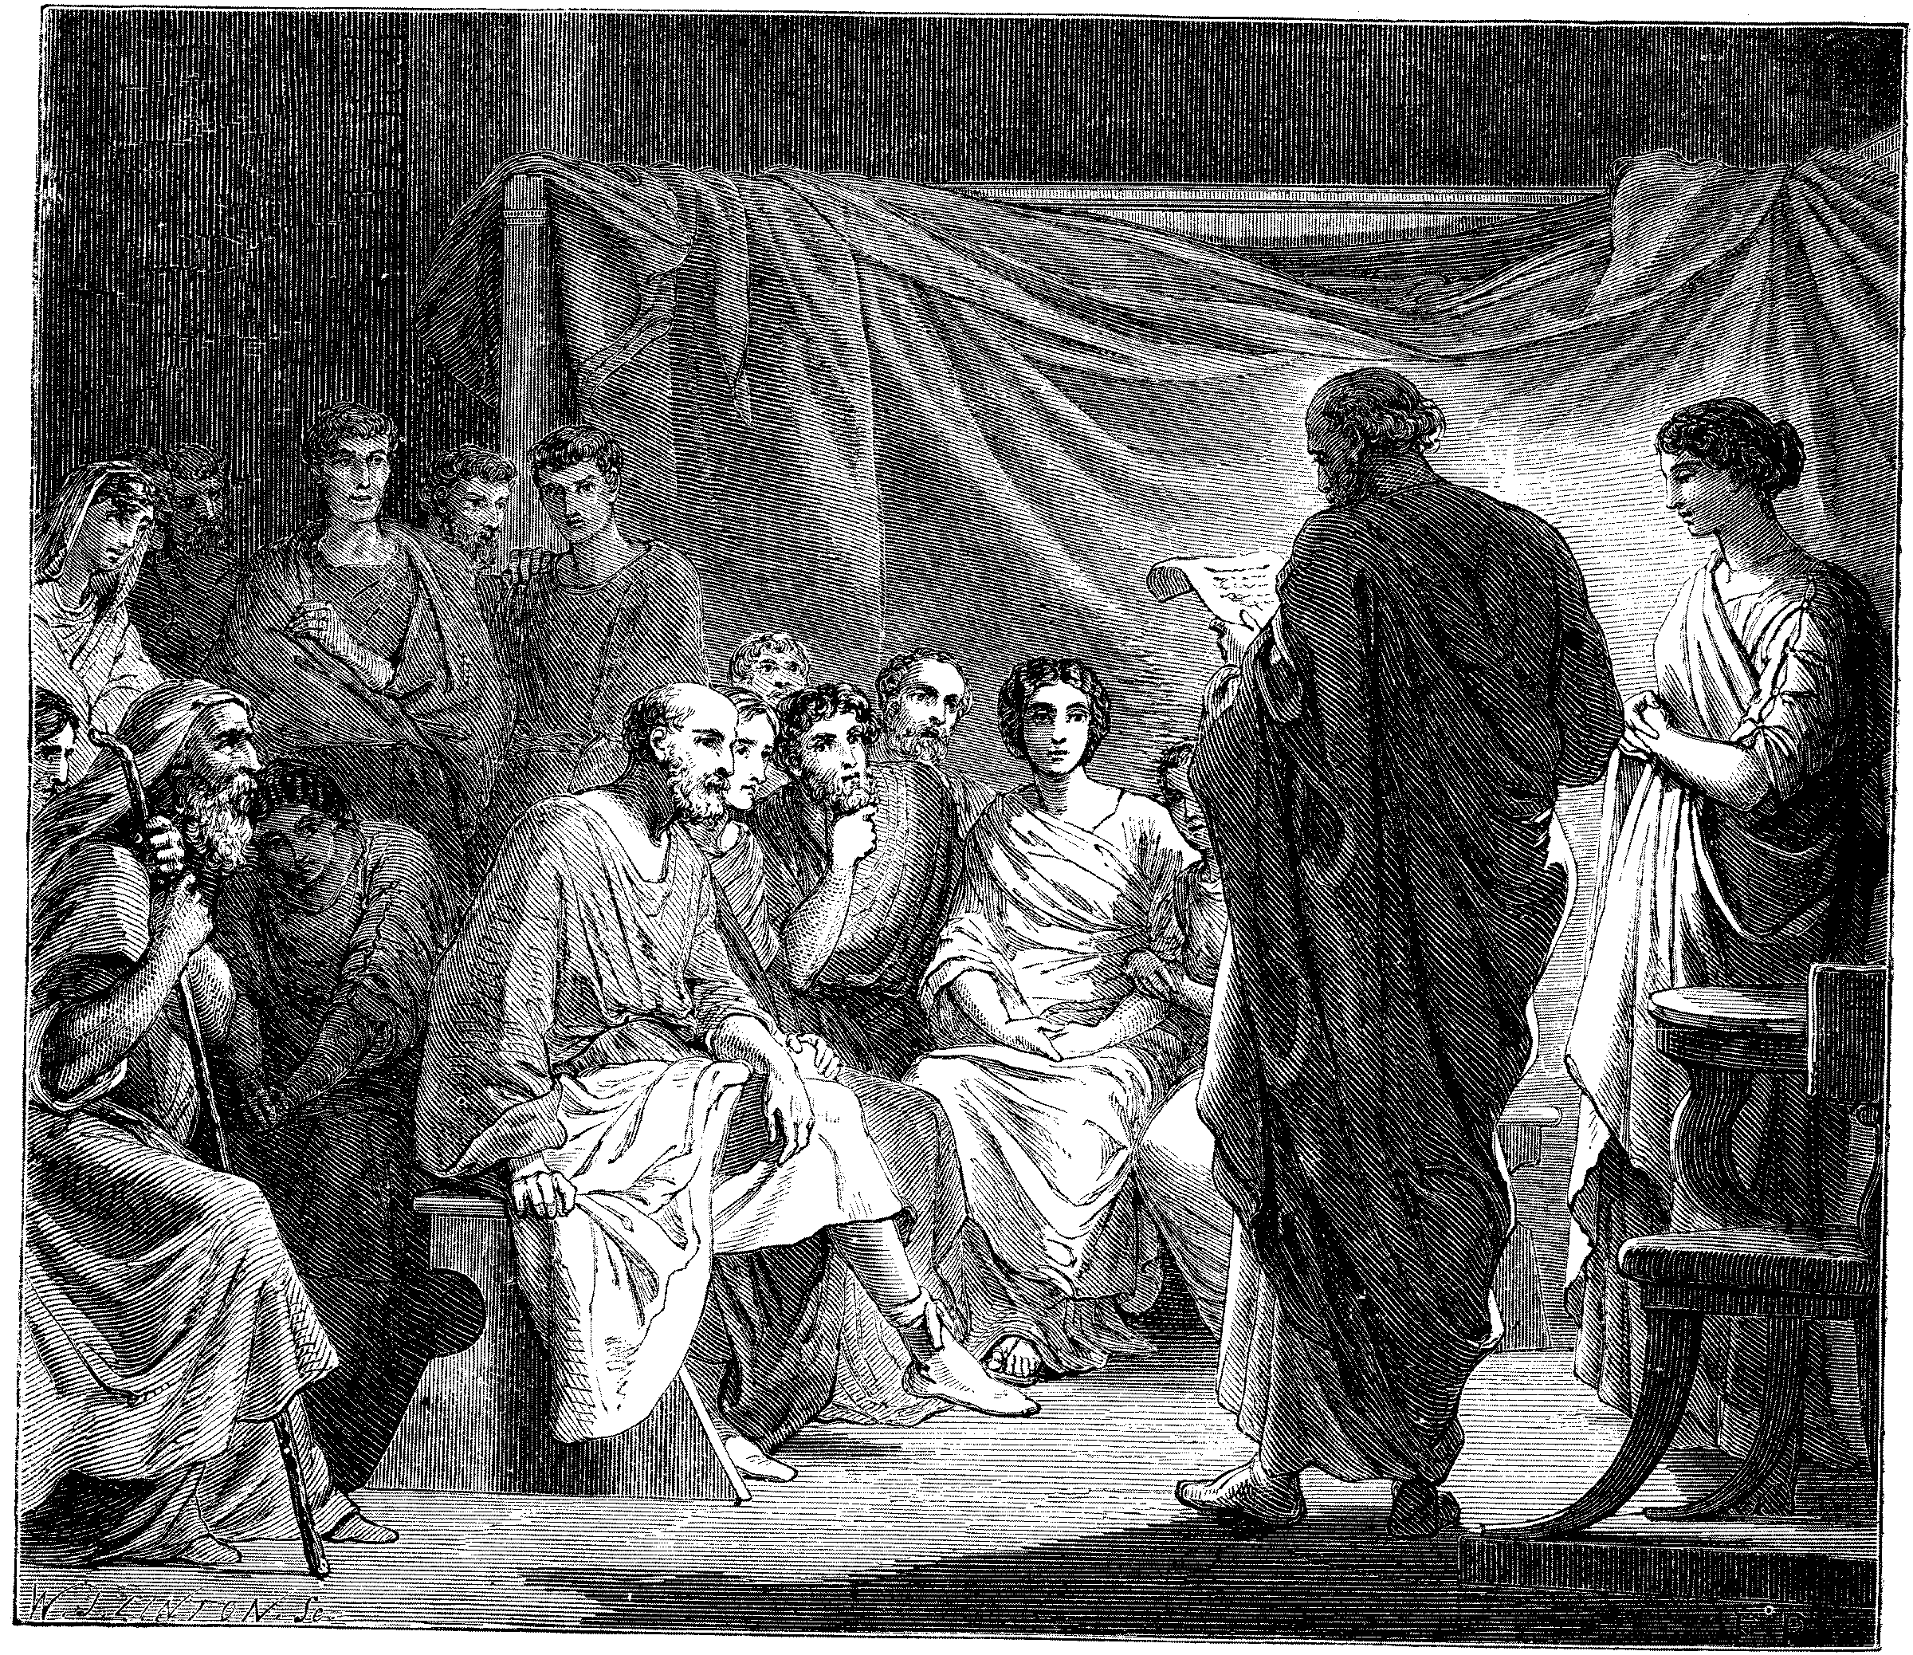
Problems In The Church Required Letters
1 & 2 Corinthians
Disunity Through Partyism
Taking Brothers To Law
Incest
Denial Of The Resurrection, etc.
Colossee – Mysticism, Gnosticism
Revelation – 7 Churches – All With Problems
Acts 20:28ff – Paul’s Warnings

Slide 8
The Church Went Into Apostasy
Emperor Worship Mixed With Church Apostasy Led To A Leaving Of The Truth Of The Gospel
175 A.D. – It Was Written That A Bishop Was Different From An Elder, One Bishop Over Elders
250 A.D. – Development Of One Bishop Over Diocese
606 A.D. – Boniface III – First Universal Head – Pope
580 A.D. – Attempts To Add Instruments To Worship Were Rejected
By 640 A.D. – Reintroduced And Accepted
By 1100 – Papal Customs, e.g. Holy Water Introduced
By 1200 – Baptism By Sprinkling

Slide 9
The Johannes Gutenberg Printing Press - 1454
Arguably History’s Greatest Invention
Produced In Mainz, Germany
First Produced Book: The Bible

Slide 10
The Protestant Reformation 1500-1800
John Wycliffe – English Reformer 1329-1384
Jan Huss – Czech Reformer – Burned at the stake in 1415
Ulrich Zwingli (1484-1531) —Swiss Reformer
Martin Luther — German Reformer beginning in 1517
John Calvin 1509-1564 – Swiss Reformer
William Tyndale — 1494-1536 – English Reformer and Translator of the Bible
John Knox – Scottish Reformer - 1505-1572 – Began The Presbyterian/ Church of Scotland
John Glas — 1695-1773 – Father Of Congregationalism - Scottish
Robert Sandeman - 1718-1771 – Scottish
Greville Ewing - 1767-1841
Alexander Campbell – Young Student of Greville Ewing At The University of Scotland

Slide 11
Restoration In The Americas
Barton W. Stone and others began a movement back to the Bible at Cane Ridge, Kentucky in August, 1801
Thomas and Alexander Campbell began restoration of the ancient order around Washington, Pennsylvania in 1809
Other smaller movements were beginning around the new Country.
January, 1832 Unity in the Stone/Campbell Movement Took Place in Lexington, Kentucky

Slide 12
Early Conversions Among African-American Culture
"In these early days slaves drove their masters to the services, others living near came and stood on the outside while several went in to assist with the children or to do any other kind of work assigned. Some of the slaves being deeply impressed, sought spiritual guidance. They were already in Hades and to hear a man of God tell them how they might secure peace and sit down at the welcome table pleased them very much. They did not choose to go to a torment greater than the one already experienced. It had been hard to understand the preaching, but now this simple way of telling the old, old story appealed to most of them. Several were added to the church. Often these went back and told the news to the other slaves. Many believed and were baptized; others were taught by the masters and their families. At times the most gifted among the slaves were trained and allowed to preach to the rest. Occasionally slaves were gathered in separate buildings and were preached to by the evangelists either before or after the regular service." —Alfred J. DeGroot and Winfred E. Garrison, The Disciple of Christ, St. Louis: The Bethany Press. 1948, p. 469.

Slide 13
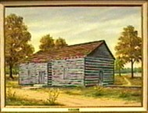
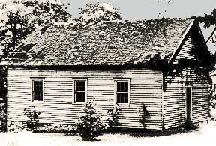
The Slave Culture Worshipped With The Whites In Many Locations
Cane Ridge, Kentucky
Brush Run, Pennsylvania

Slide 14
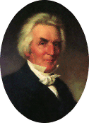
Early Preachers Evangelized Among African-Americans
In the book, “Roll Jordan Roll,” J.E. Choate reported, that an ex-slave who lived in California by the name of G.A. Goins spoke of Alexander Campbell saying, “Mr. Campbell was a great debater. I saw him many times, with his own hands, baptize black men and women. I never tired of hearing him speak. He always had something to say."

Slide 15
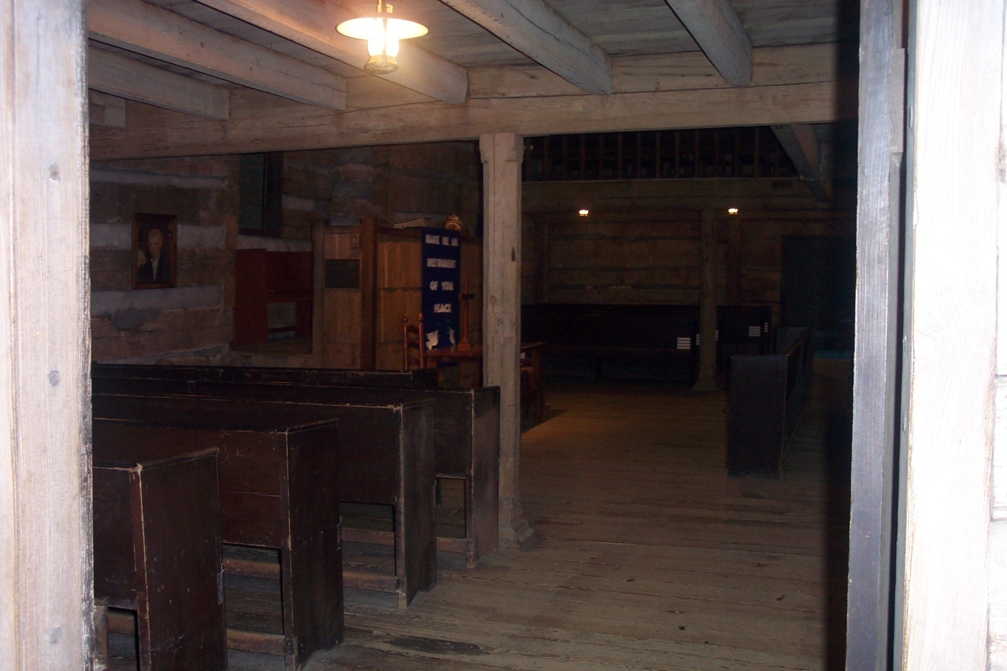
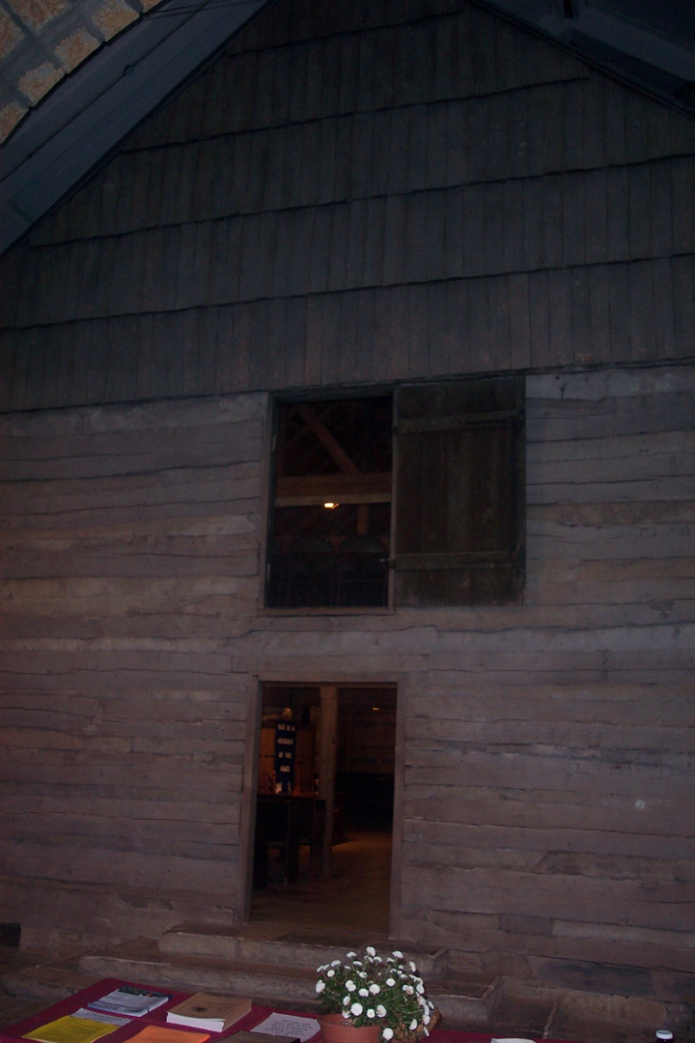
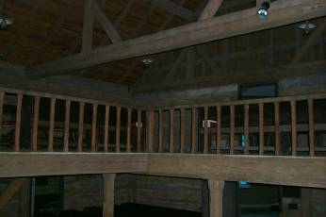
At Cane Ridge, Kentucky The Slaves Sat In The Gallery Of The Church

Slide 16
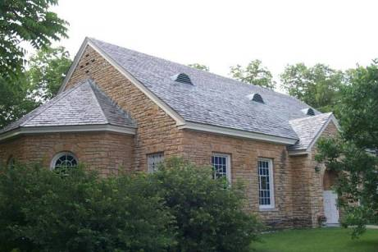
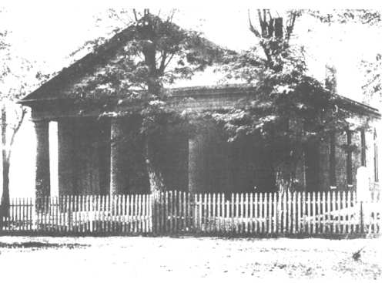
A Freed Slave By The Name Of Alexander Campbell
One Slave Baptized Into Christ at Cane Ridge Was A Man By The Name Of Alexander Campbell
He was freed to preach among the blacks enslaved by many of the white members.
He later moved to Midway, Kentucky where the white brother there built a building for the blacks to worship. He baptized over 300 into Christ there.
As growth among the African-American brethren developed, the white brethren encouraged their meeting on their own, often helping to build their church buildings, showing the beginning of segregated meetings.
Cane Ridge
Midway Meetinghouse

Slide 17
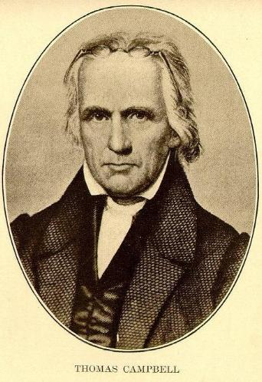
Preaching Among African-Americans Was Not Always Welcomed In Some Locations
In 1817, Thomas Campbell, father of Alexander, moved his family to Burlington, Ky. to start a school. In the summer of 1819 he noticed some blacks “amusing themselves in a grove,” as was their Sunday tradition. He approached them and asked them if they wanted to come into the school house to allow him to read the Bible to them. They obliged. On the next day he was approached by a friend who told him that it was illegal to teach the black people. He was so angered by this ungodly law that he closed the school and immediately returned to Virginia, where such foolishness was not considered.

Slide 18
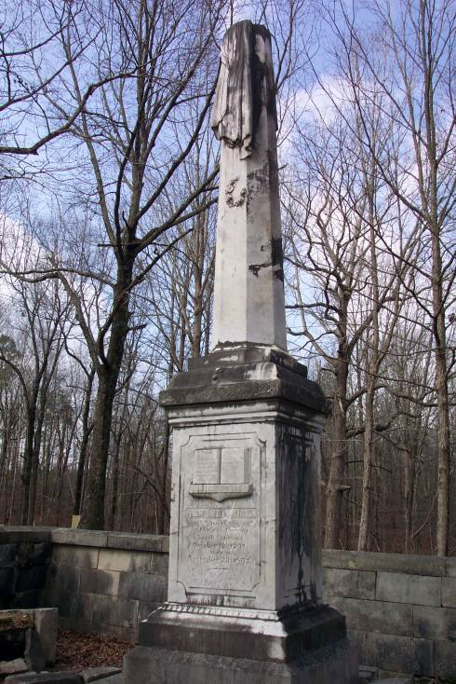
Many Plantation Owners Believed The Gospel Should Be Taught To Their Slaves
Abraham Ricks, a landowner in Northwest Alabama, who was baptized by Alexander Campbell, so believed in the teaching of the gospel to his slaves that he baptized his slaved George Ricks, taught him to preach among the slaves, and even built his slaves their own church building.

Slide 19
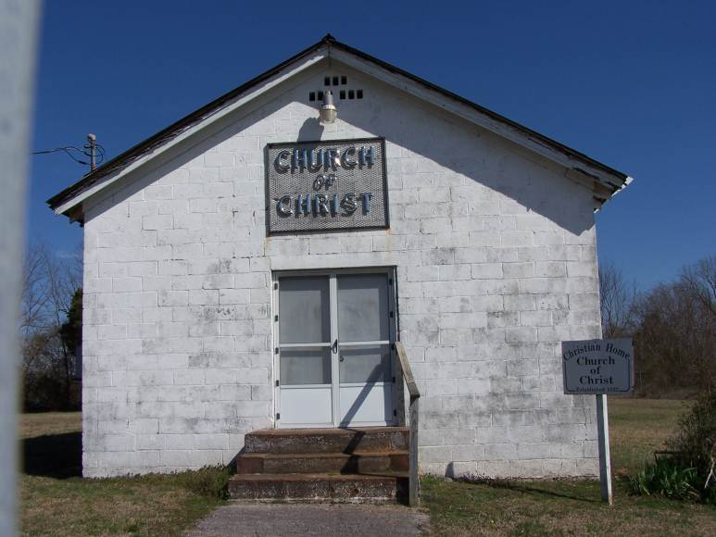
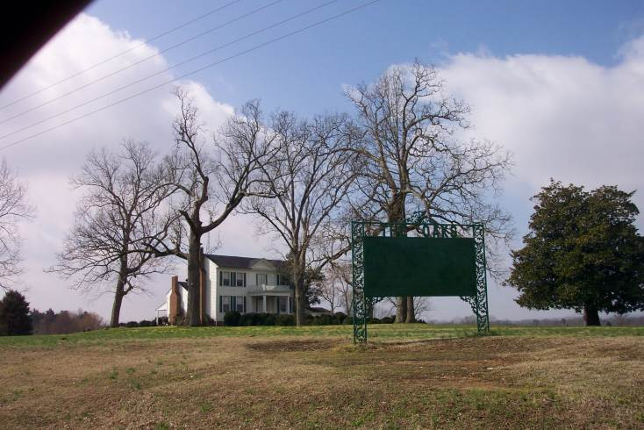
The Church Building Built For The Slaves By Abraham Ricks Where George Ricks Preached
The Ricks Plantation Home As It Looks Today, Near Tuscumbia, Alabama

Slide 20
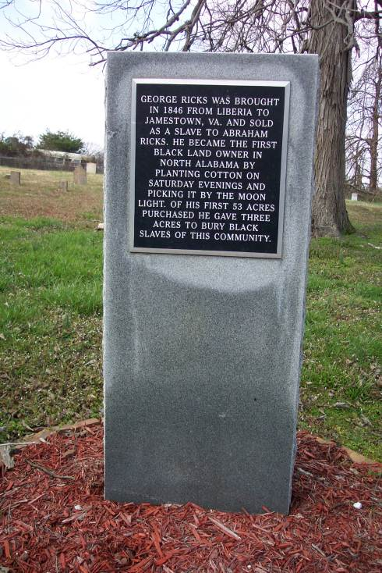
George Ricks was brought in 1846 from Liberia to Jamestown, Virginia and sold as a slave to Abraham Ricks. He became the first black land owner in North Alabama by planting cotton on Saturday evenings and picking it by the moonlight. Of his first 53 acres purchased he gave three acres to bury black slaves of this community.

Slide 21
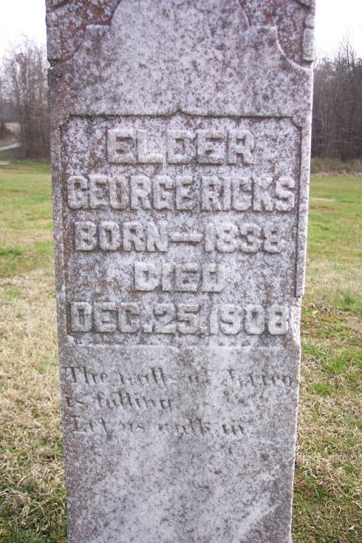
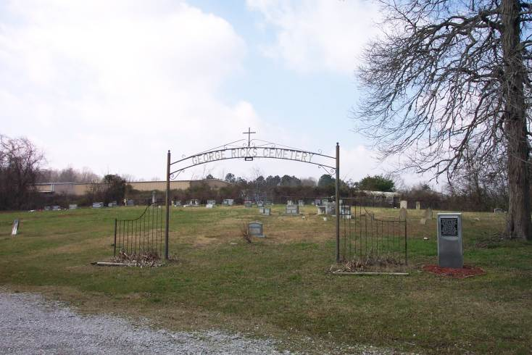
George Ricks Cemetery & Grave

Slide 22
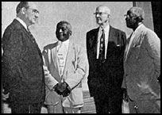
Percy Ricks, Was The Grandson Of George Ricks.
His Wife’s Sister, Laura, Was The Second Wife Of Marshall Keeble
LtoR: Athens Clay Pullias, Marshall Keeble, J.W. Brents, Percy Ricks

Slide 23
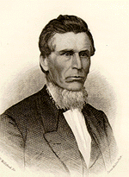
The Evangelism Of “Old Dick”
1853, Richfield (now Missouri City), Missouri, a gospel meeting with Moses E. Lard
The slave “Old Dick” had brought his 16 year old master, Thomas to the meeting, travelling 15 miles that morning.
Lard decided to preached to Thomas. Thomas responded to the invitation. “Old Dick” stood in the back of the building and clapped his hands with excitement.
A couple weeks later, Lard was passing through the town where Thomas and “Old Dick” lived. He was met by the slave, and begged to come preach just once.
He preached 2½ hours, and four men responded. He stayed until 40 people were baptized, starting the church at South Point
Notes:
Kenneth Van Deusen, author of Moses Lard, pages 77ff tells that story of how in 1853, young Moses Lard, just a few years out of Bethany College was preaching a meeting at Richfield, Missouri. As he arrived, while hitching up his horse, an old slave man came and asked to speak to him. He told him that he was a member of the church over in Stanley about 15 miles away. He had been baptized by Brother Warriner, a dear old preacher friend of Lard. Warriner had died a few years previous and the church in Stanley had fallen into disarray. Then he told him that he had heard Lard was preaching there, and had told his master that he needed to hear him. So, early that morning, he and his 16 year old Master, Thomas road the 15 miles to hear Lard. Lard was so moved by the evangelistic heart of Dick, that he intended to preach primarily to Thomas. At the invitation, Thomas responded. Dick was so moved with excitement, he could neither sit nor stand. He wanted to yell but saw it was inappropriate, so he clapped his hands together, and was filled with thanks. Thomas was baptized that evening.
Two weeks later, while travelling through Stanley, Lard looked in on Thomas and his slave old Dick. Dick told him that since his conversion that denominations had been preaching against Campbellism. He said he’d been praying that if Brother Lard could just come and preach one sermon, it would certainly shut them all up. So, he begged Lard to stay and preach. Lard said he had an appointment, but would be back through in a couple weeks. In the meantime, Dick was told to make a clearing in a grove, and level off a stump, upon which he could stand. Since all the church buildings were locked to Lard, he preached to a large group on a Wednesday morning in the grove. He preached for 2 ½ hours, resulting in 4 men being baptized. He resolved to preach again the second day with more results, and a third and fourth, with still more results. Before it was over 40 people had been baptized, and the church at South Point was started. The church later grew to over 300. Lard never forgot the evangelism of a slave which brought the gospel to white men in a small community in northern Missouri.

Slide 24
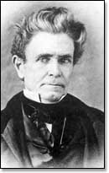
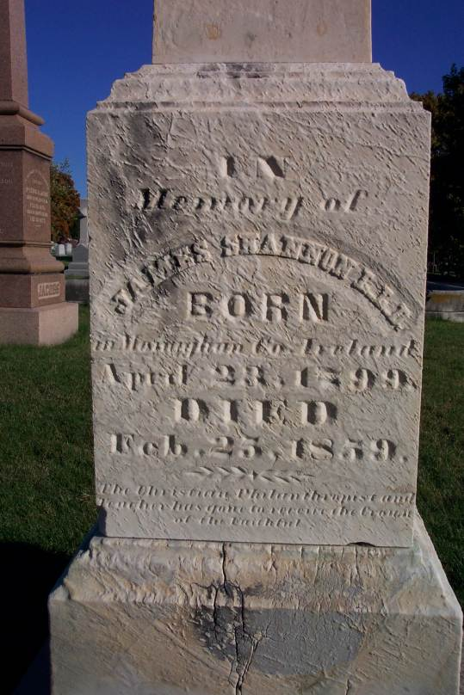
How White Brethren Viewed Slavery
Many brethren, especially in the industrialized north spoke out strongly against slavery, writing in journals.
Most preachers however, chose to ignore the issue, just accepting that it was part of the culture.
Alexander Campbell believed that the slavery issue was best dealt with at the voting booth, yet laws had to change first, since land/slave owners were given extra votes depending on the amount of slaves they owned.
Some brethren, like James Shannon, attempted to defend slavery Biblically

Slide 25
Numerous African American Congregations Had Early Beginnings
Other African American churches included: Midway, Kentucky – 1834; Pickerelltown, Logan County, Ohio – 1838; Lexington, KY – 1851; Hancock Hill Church, Louisville, KY – early 1850s; Free Union Church of Christ, Uniontown, NC – 1854; Grapevine Christian Church, Nashville, TN – 1859; Little Rock Christian, Bourbon Cty. KY – 1861 & Churches in Georgia were found in Washington, Johnson, and Wilkinson Counties

Slide 26
Records Of Early African-American Preachers & Their Works Are Sketchy
Samuel Buckner & Alexander Campbell – Cane Ridge, Paris, Kentucky
Isaac Scott – Raleigh, North Carolina
Abram Williams – Somerset, Kentucky
Thomas Phillips – Lexington, Kentucky
J.D. Smith – at Louisville, Kentucky
Henry Newson – Pickerelltown, Ohio
Peter Lowery -- Nashville, Tennessee
Hesiker Hinkel – Washington County, Tennessee

Slide 27
Before, During The Civil War & Years Of Reconstruction
By 1861 the African American membership in mixed congregations numbered about 5,500, and in separate congregations about 1,500.
During The Civil War The Church Suffered Extensively In Most Places, Often Churches Had To Close Their Doors
As the war involved mostly the whites, especially in the south, the black brethren were left to their own pursuits
After the war, the growth of segregation continued to drive a wedge between black and white cooperation
Innovations such as the Missionary Societies and the addition of the instrument to many of the assemblies among black congregations led to separations in fellowship, as it did among many of the white churches

Slide 28
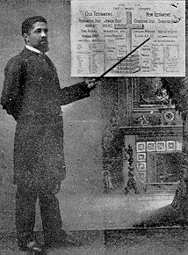
S.R. Cassius
Samuel Robert Cassius (1853-1931)
As A Child, Shook The Hand Of President Abraham Lincoln
Began Preaching In Sigourney, Iowa in 1880
1891 Moved To Oklahoma Territory To Preach Among Blacks And American Indians (the first work of its kind)
1892 – Springvale Township, Oklahoma – The first Black Congregation In Oklahoma Territory
1899 – Called And Conducted The First Annual Meeting Of Black Brethren In Oklahoma
1902 – Made A Trip To The West – Being The First Black Preacher To Preach In Los Angeles, California

Slide 29
S.R. Cassius
1909 – Established The Missionary Executive Board Of Colored Disciples In Oklahoma
1915 – Established A Work In Austin, Texas
1924 – He, With His Son, Amos Lincoln Cassius, Began The First Black Congregation In Los Angeles
1927 – Established Work Among Blacks In Denver, Colorado
He Wrote For The Christian Echo, Gospel Advocate, & Christian Leader
1920 – Wrote “Third Birth Of A Nation” – A Book On Racism In America
Died August 10, 1931 in Colorado Springs, Colorado

Slide 30
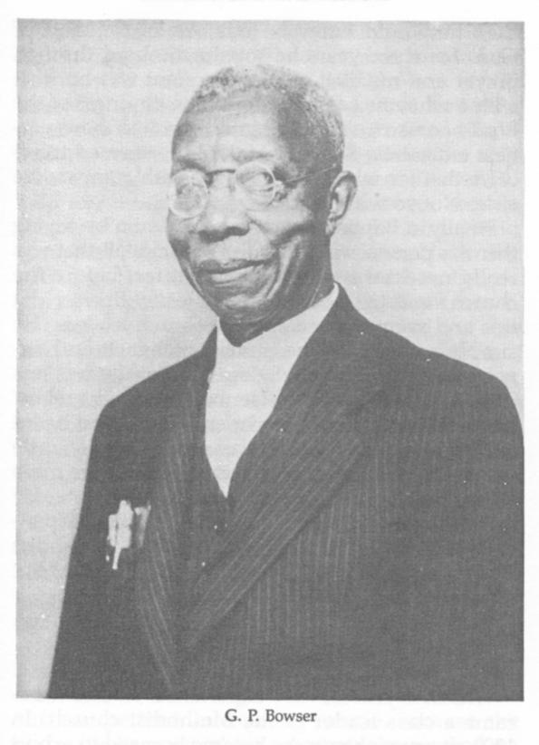
G.P. Bowser
George Phillip Bowser was born February 17, 1874 in Maury County, about sixty miles south of Nashville, Tennessee.
When G.P. was very young his father was killed and his mother moved the family to Nashville where she worked hard to see that her children were well educated.
After finishing grade school he took the opportunity to attend Walden University where he mastered five languages in addition to English: Greek, Hebrew, French, German and Latin.
G.P. was very religious and his childhood religious experience in the Methodist church was giving him second thoughts.
Sam W. Womack, and other Christians in Nashville, took interest in him, teaching him the truth and he soon obeyed the Gospel and started preaching it.

Slide 31
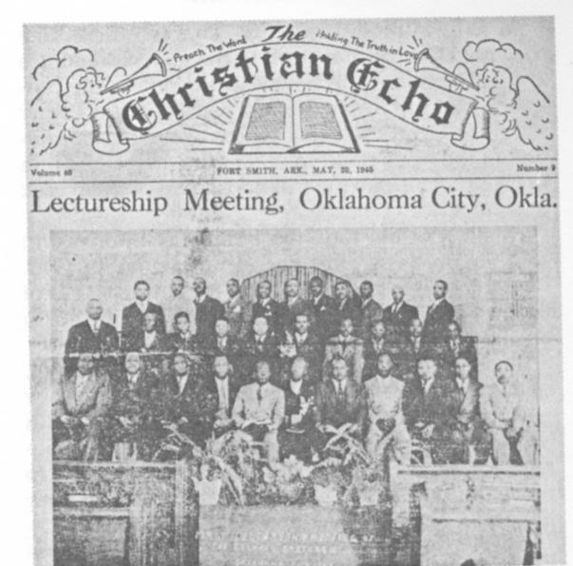
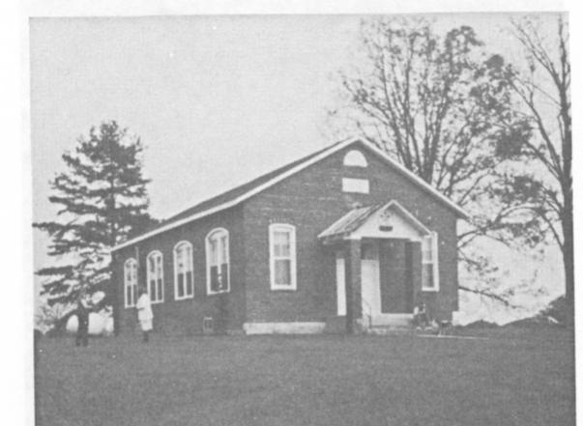
G.P. Bowser
Even though he lost his left arm earlier in life in an accident he became a master printer and at the age of twenty-eight, he edited a newspaper called, "The Christian Echo."
He started a Christian school for black children on Jackson Street in Nashville and opened it on January 6, 1907.
He also started a school in Silver Point near Cookville, Tennessee
He was instrumental in setting up schools in Detroit, Fort Worth, Ft. Smith, Arkansas and a University in Terrell, Texas.
This great man dedicated his life to Christian education among blacks.
He died March 23, 1950.
The Christian Echo
Silverpoint School

Slide 32
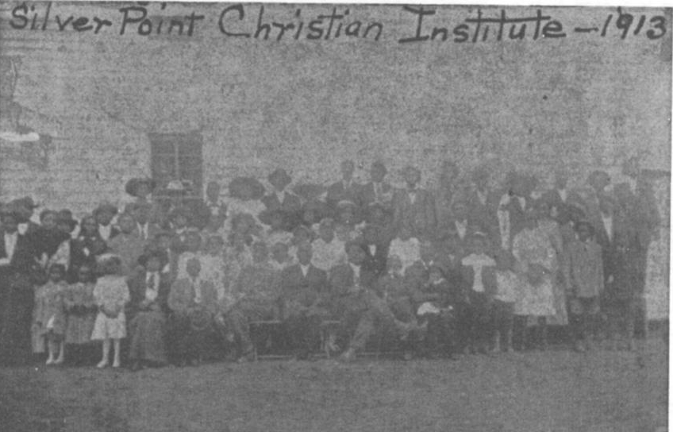
The school at Silverpoint, Tennessee began with the organization of S.W. Womack, Alexander C. Campbell, and G.P. Bowser. It had started in Nashville in October, 1907. Then moved to Silverpoint, TN in 1909. The school closed in 1920

Slide 33
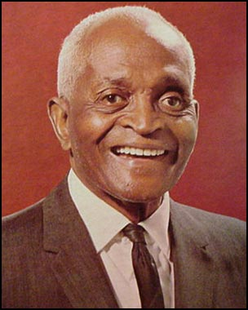
Marshall Keeble: Evangelist
Born of slave parents on a farm near Murfreesboro, in Rutherford County, Tennessee, on December 7, 1878
At Age 4 his family moved to Nashville, Tennessee. He attended schools, but not beyond the 7th grade
He married Miss Minnie Womack, a Fisk University high school graduate, and daughter of gospel preacher, S.W. Womack
Five children were born to the Keebles, and after 36 years of marriage, Minnie died December 11, 1932.
With the help of S.W. Womack and others Keeble began preaching in 1897.

Slide 34
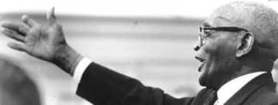
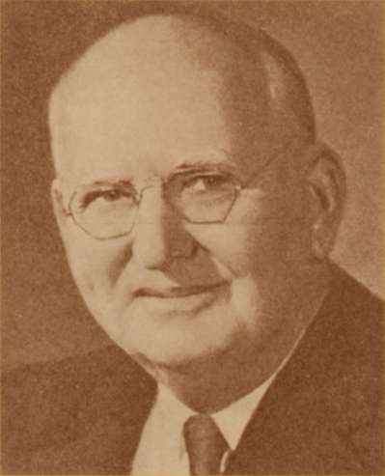
Marshall Keeble: Evangelist
In 1914, Keeble decided to "preach the gospel" on a full-time basis.
Between 1915 and 1918, he traveled more than 23,000 miles, preached 1,161 sermons and baptized 457 persons.
In 1920, A.M. Burton, founder of the Life and Casualty Insurance Company, became his friend and patron.
He traveled extensively at Burton's expense and was supported by the Nashville company. During his life he preached from the Golden Gate Bridge to New York harbor and around the world.
A.M. Burton

Slide 35
Marshall Keeble: Evangelist
In 1934, after a formal courtship, Keeble married his second wife, Laura Catherine Johnson (1898- ) of Corinth, Mississippi.
Eight year's after his marriage to Laura Johnson, he became the first president of the Nashville Christian Institute (NCI) in 1942.
Opening in 1940, NCI served as a night school for adults.
The same year that Keeble became president, NCI opened a fully accredited elementary and high school.
He served the school as president until 1958 when he became President Emeritus.
NCI closed on June 2, 1967.

Slide 36
During his career, Marshall Keeble received many honors. He was the first African American to become the subject of academic studies among leading preachers of the churches of Christ.
In 1954, he was honored as the "Man of the Hour", on WLAC sponsored by the Business and Professional Women's Club.
In 1956, he was presented a citation by President Hugh H. Tiner of George Pepperdine College.
In 1960, he was made an honorary chief of the Nigerian tribe
In 1964, he was featured in the "Magazine Section" of the Nashville Tennessean.
In 1965, Harding University in Arkansas awarded him an honorary doctor of Law degree \
Governor Frank G. Clement appointed him the first African-American "Colonel Aide-de-Camp", an honorary colonel on the Governor's staff
Nashville Mayor Beverly Briley presented Keeble (on his birthday) with a bronze plaque.

Slide 37
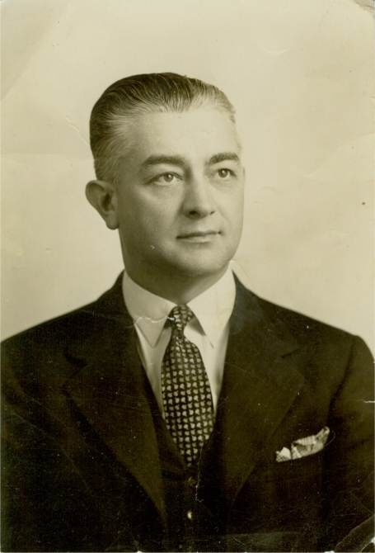
Marshall Keeble: Evangelist
In 1931 H. Clyde Hale, minister of West End Church of Christ invited Marshall Keeble to Atlanta, as no black congregation existed at that time
According To Hale A Suitable Site Was Selected By The White Brethren For The Pitching Of A Tent. When Keeble Saw The Location, He Said “Drive On!” After driving down further into the black section of town a more suitable location was found for the tent
As many as 2500 attended the tent meeting and no less than 1000 per night
After one week only one woman was baptized. Not discouraged Keeble preached two more weeks baptizing 166
These were the first members of the Simpson Street Church of Christ
Henry Clyde Hale

Slide 38
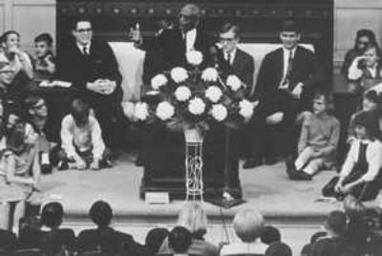
Marshall Keeble: Evangelist
For years Keeble was a popular preacher not only among the blacks, but he successfully broke the race barrier in many places, being a popular speaker among whites as well.
He appeared on lectureships, in tent meetings, and under brush arbors.
It is estimated that he established 400 congregations & baptized in excess of 40,000 people in his life time.

Slide 39
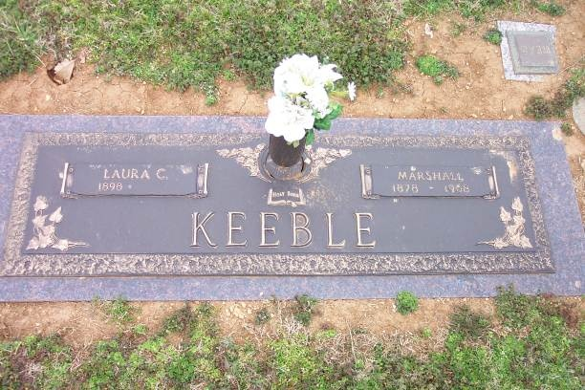
Marshall Keeble preached his last sermon on April 17, 1968.
He passed from this life April 20, 1968 and is buried in the Greenwood Cemetery, Nashville, Tennessee, located at 1428 Elm Hill Pike.
Laura Keeble still lives in Nashville, Tennessee, Nursing Home, at the age of 108

